Slide 1
ARTIFICIAL INTELLIGENCE IN MAMMOGRAPHY
The Scottish Perspective
Breast Imaging Special Interest Group
16 January 2020
Dr Gerald Lip
Clinical Director, North East Scotland Breast Screening Programme
Chair, National Users Group for the Breast Screening IT System
Chief Investigator (Breast), Industrial Centre for Artificial Intelligence and Digital Diagnostics

Slide 2
Introduction
The Scottish Breast Screening Programme (SBSP) delivers a service via 6 centres to women aged between 50-70 who are invited every three years
Screening services are devolved and delivered separate but all 4 UK administrations follow similar guidelines and standards
The SBSP is delivered via a recently developed web based information management system SBSS (2016) and all units in Scotland have now converted to digital imaging since early 2015.

Slide 3
Scottish Breast Screening Programme (SBSP)
Currently images are reported by two consultant radiologists with specific training in mammography, who are required to meet performance criteria of the SBSP for both detection and recall rate
Around 250,000 women are invited for screening in Scotland each year. Not all attend and in any three year cycle around 600,000 mammogram examinations are acquired and reported

Slide 4
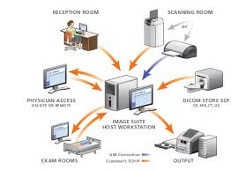
Scotland has major strengths
National Health Service (NHS)
National picture archiving & communication system (PACS)
Single patient identifier: community health index (CHI)
Network of accredited Safe Havens
Strong partnerships between NHS, universities and industry
Existing clinical and research networks
CHI
Number
Notes:
Ideal landscape in Scotland for this to happen with unified NHS, single identifier CHI, national PACS/RIS, network of safe havens (Emily will provide more detail), triple helix of existing strong partnerships between NHS, universities and industry. Use this as fantastic opportunities slide – we are building on very strong NHS/University/Industry collaborations and in such a small country we know many of key people already

Slide 5
Breast Screening Scotland has major strengths too
Separate National Breast Screening PACs
National Breast Screening Fully Digital Electronic Patient Record
National reported quality assurance performance measures
Notes:
Ideal landscape in Scotland for this to happen with unified NHS, single identifier CHI, national PACS/RIS, network of safe havens (Emily will provide more detail), triple helix of existing strong partnerships between NHS, universities and industry. Use this as fantastic opportunities slide – we are building on very strong NHS/University/Industry collaborations and in such a small country we know many of key people already

Slide 6
iCAIRD
Industrial Centre for Artificial Intelligence Research in Digital Diagnostics
Innovate UK & industry partners
£15M

Slide 7
Why AI in screening mammography?
Because mammographic reporting is repetitive and high volume
Potential of AI to maintain or increase cancer detection rate without increasing the recall rate. Less false positives.
In Scotland, there is a workforce crisis with a shortage of radiologists. There is a long lead time to training as well whether for radiologists or advanced practitioners.

Slide 8
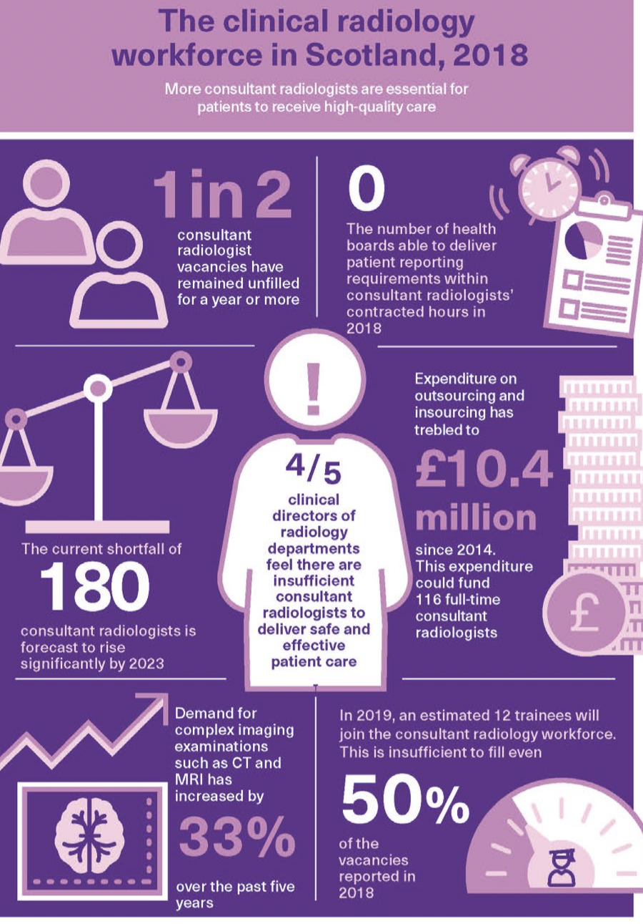
Notes:
Scotland’s radiology workforce crisis in depressing numbers that will be familiar to radiologists in the audience: unfilled vacancies, no health organisation can meet reporting requirements, outsourcing costs £10.4 M (that’s about 1,400 million Yen), the current consultant shortfall is 60% of the workforce, training numbers won’t fill even half the projected vacancies, there has been a 33% rise in complex cross sectional (CT and MRI) over past 5 years. I’m sure this will be a familiar set of numbers to most radiologists in the room and in English we have a saying “drowning, not waving”

Slide 9
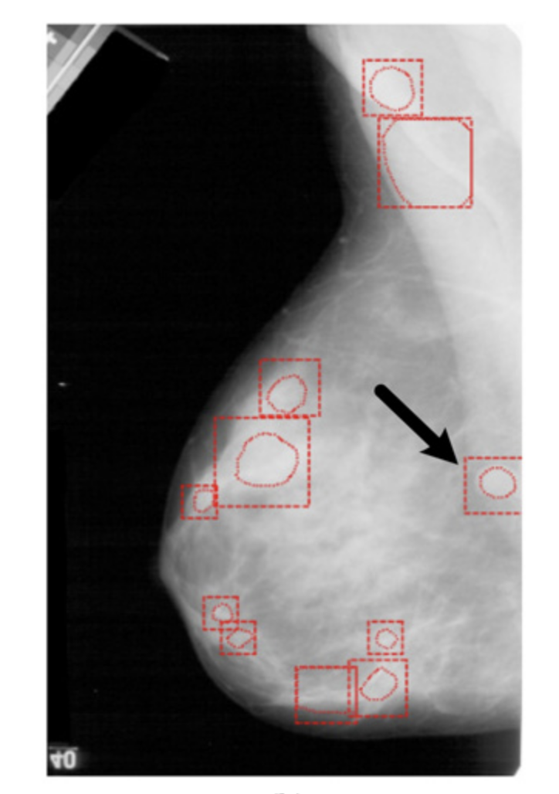
Have we been here before?
Diagnostic Accuracy of Digital Screening Mammography With and Without Computer-Aided Detection - Lehman CD, Wellman RD, Buist SM. JAMA Intern Med. 2015; 175(11): 1828-1837
Screening performance was not improved with CAD on any metric assessed.

Slide 10
How is AI better?
Computing power has increased
Change from film to digital mammography
Ground truth datasets are more accurate
Development of machine learning and convoluted neural networks

Slide 11
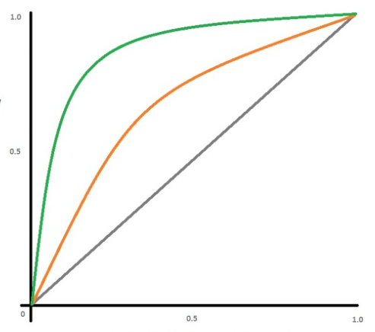
Measures of performance
Area under the curve (AUC)
AUC enables comparison between humans and AI. The greater the AUC (up to the max 1.0), the more accurate the test is (both better sensitivity – can identify positives - and specificity – can minimise false positives).
A guide to AUC values:
0.90-1.00: excellent accuracy
0.80-0.90: good accuracy
0.70-0.80: fair accuracy
0.60-0.70: poor accuracy
0.50: no discriminating ability
Sensitivity
Specificity

Slide 12
In 2017, four teams achieved AUC > 0.9, the technology was showing potential

Slide 13
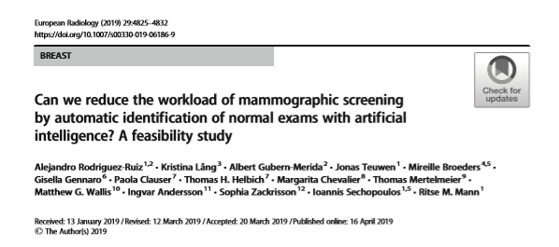
Enriched data set 653 cancers in 2652 Digital Mammography exams
AI system score from 1-10 representing likelihood of cancer
Non inferior
Recall rate maintained
Threshold set at 5 reduced workload by 47% with exclusion of 7% true positives
Threshold set at 2 reduced workload by 17% with exclusion of 1% true positives

Slide 14
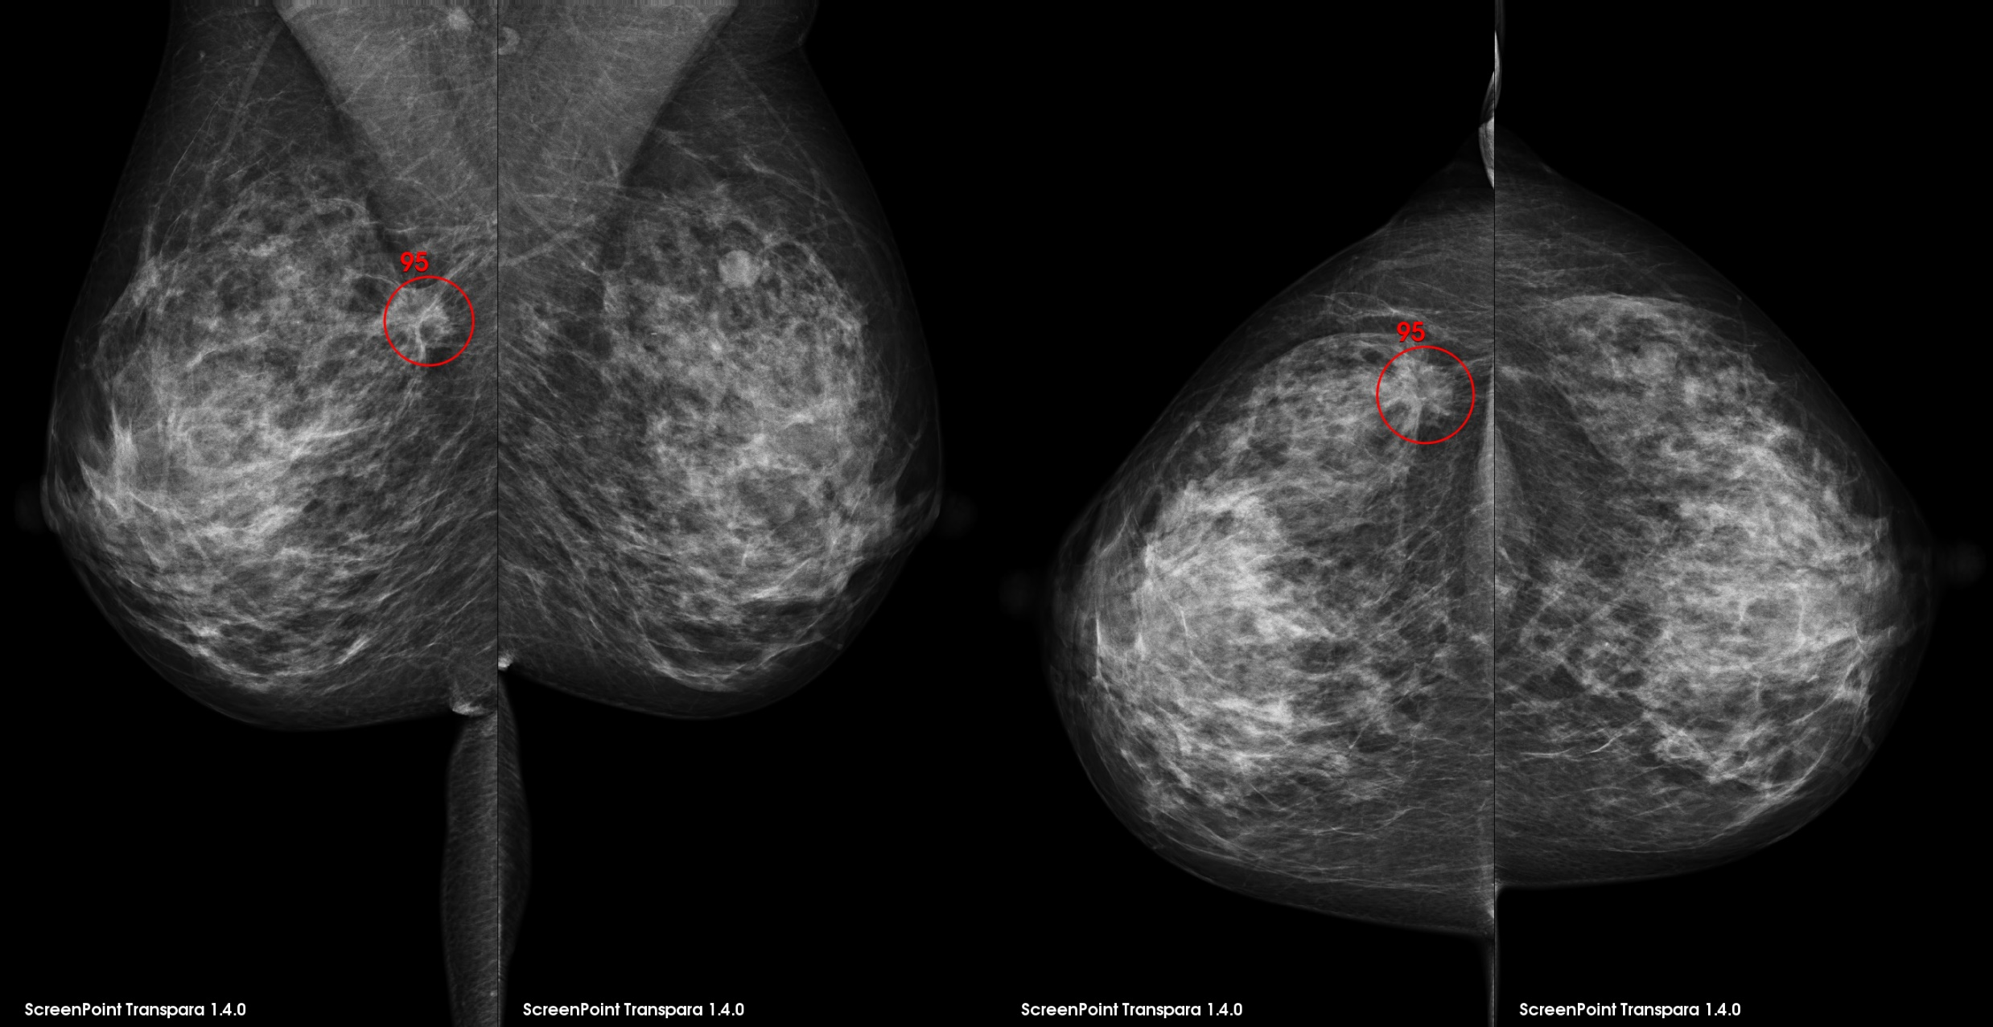
© 2019 ScreenPoint Medical

Slide 15
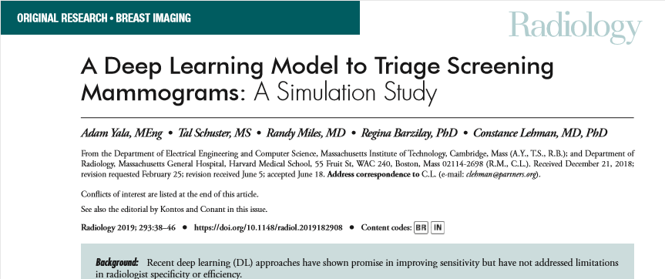
223109 consecutive screening mammograms in 66661 women
DL triage workflow
Skipped normals, radiologists read triaged mammograms
Simulated workflow had improved specificity (90.1%) with a non inferior sensitivity (94.2%) with 80.7% referred.

Slide 16
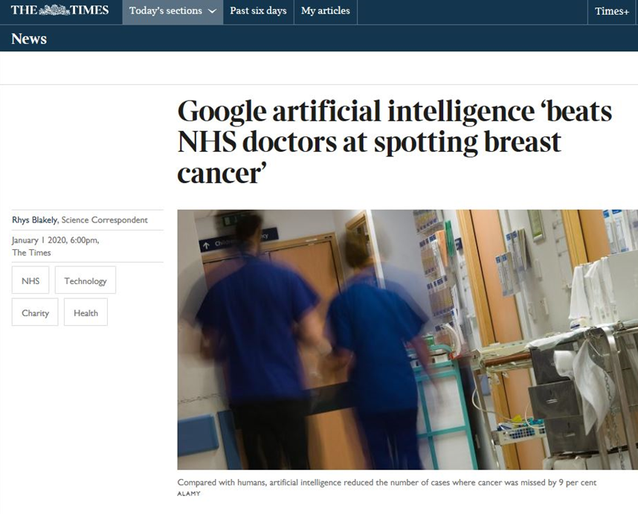

Slide 17
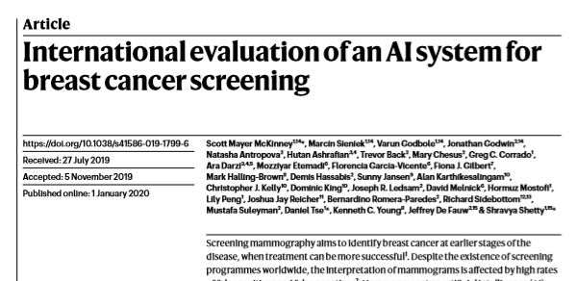
US trained data on the Optimam’s 26000 women’s images (UK) and 3000 women’s from a US database
Absolute reduction 5.7% (US) and 1.2% (UK) in false positives
Absolute reduction 9.4% (US) and 2.7% (UK) in false negatives
AUC of AI system was greater than pool of 6 radiologists by 11.5%
Simulation on the double reading process in the UK showed non inferiority and second reader workload reduction by 88%

Slide 18
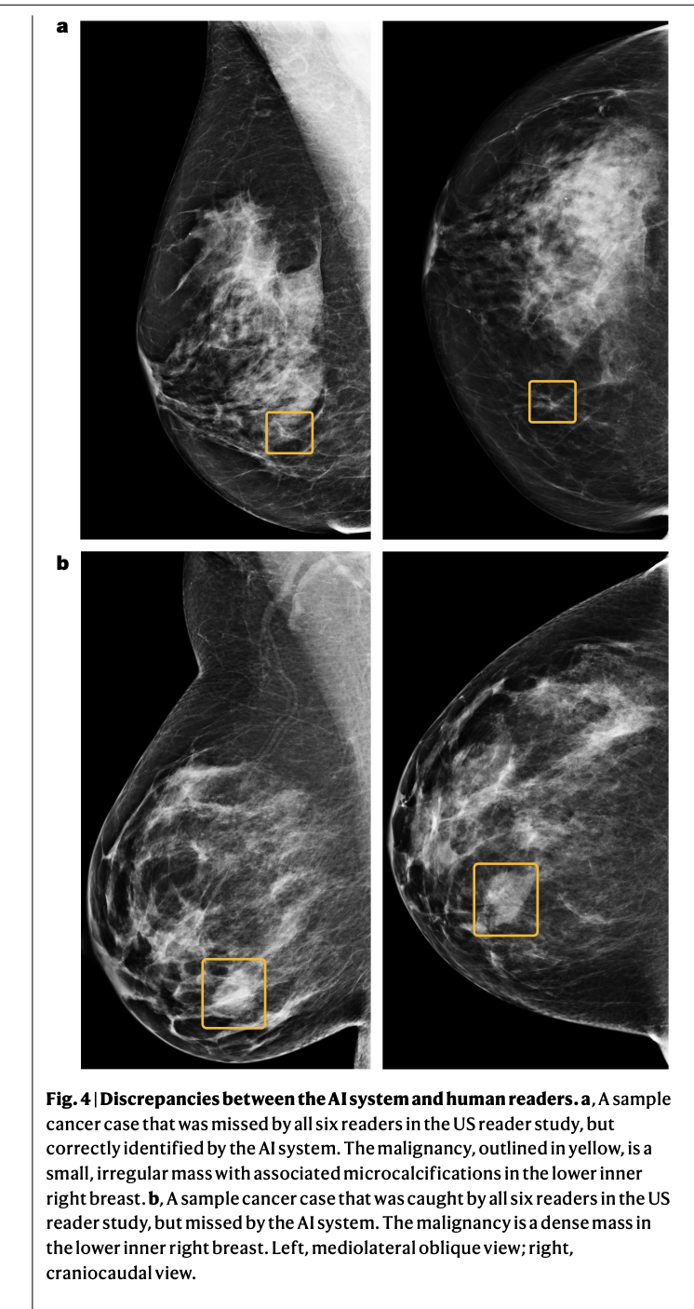

Slide 19
Four key areas to consider when developing Artificial Intelligence
Trust
Ensuring confidence of clinical community as the AI is integrated
Engaging and maintaining the confidence of the public (clarity of purpose)
Clinical
Assuring the clinical performance
Minimising ‘learned-bias’

Slide 20
Four key areas to consider when developing
Artificial Intelligence
3. Legal & Commercial
Procurement approach (e.g. pre-commercial procurement to evaluate options)
Contractual arrangements – IP ownership, licensing & potential commercialisation
Accreditation with MHRA and meet software-as-a-medical device regulations
4. Technical
Architectural design & use of API’s to integrate into clinical systems
Design of Target Operating Model to monitor and maintain the AI capability

Slide 21
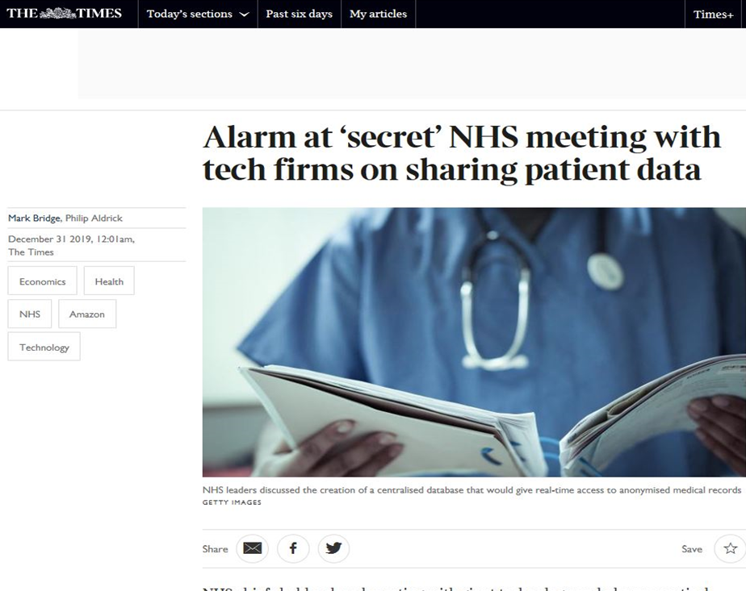

Slide 22
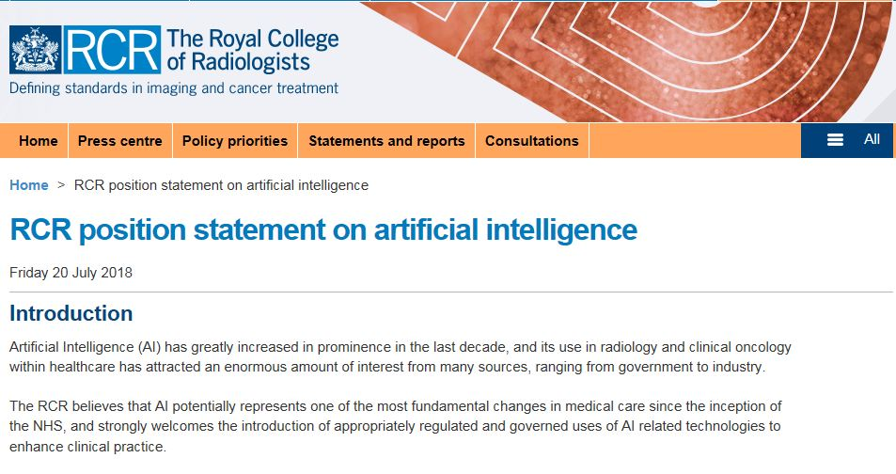
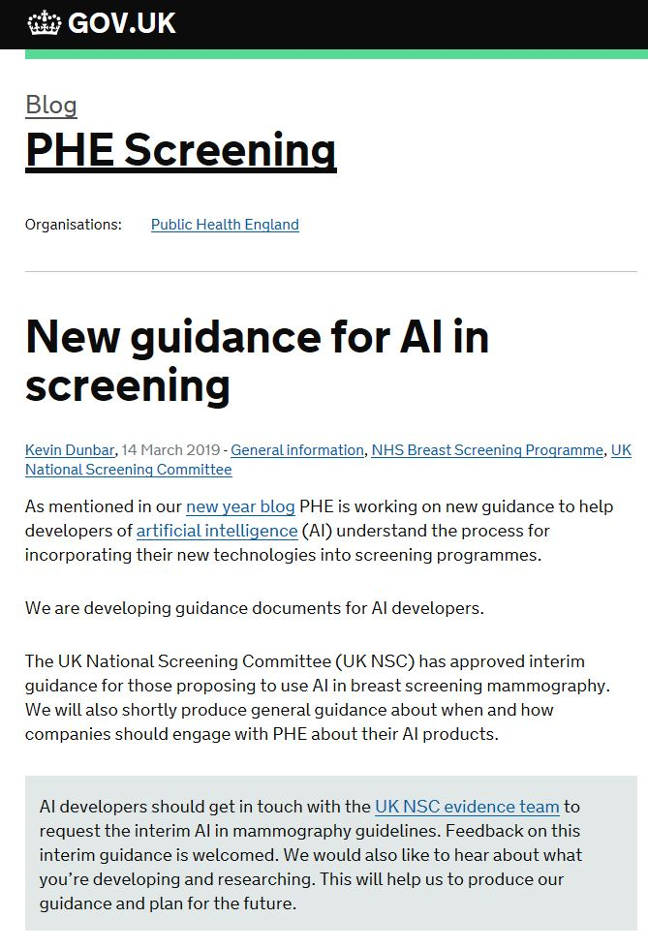
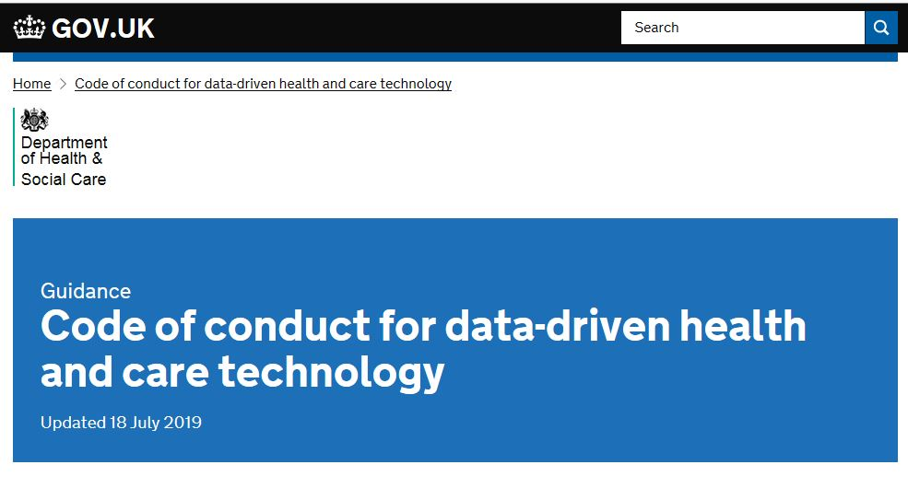
TRUST

Slide 23
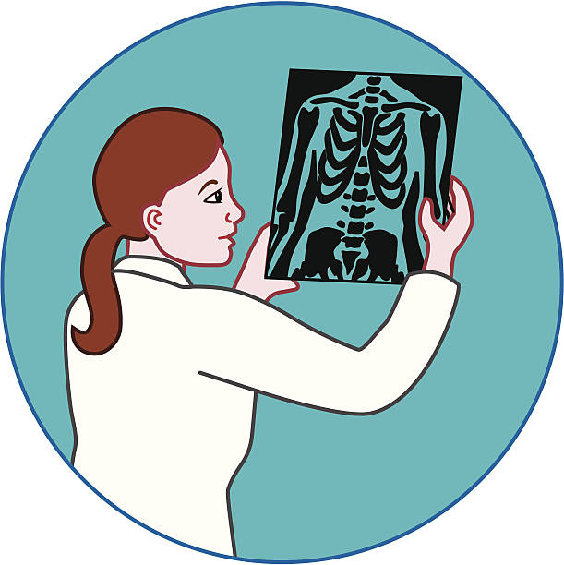
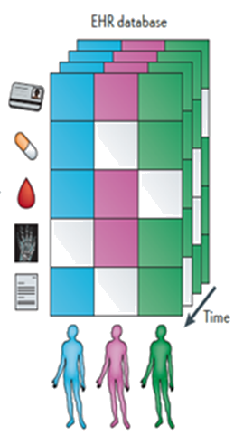
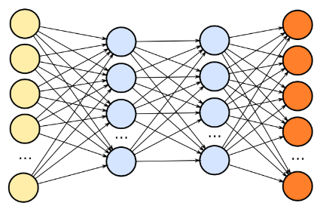
The Safe Haven AI Platform (SHAIP)
Healthcare Enterprise
Technology Company
Clinician identifies patient cohort
2
Clinician
1
Industry researcher & clinician identify need
Data Controller
Researcher
Anonymizing Data Portal
Approvals obtained from Caldicott guardian
5
Via anonymising portal researcher explores data and creates ground truth
3
Data Scientist
Approved data pulled from clinical system to workspace
WORKSPACE
4
Caldicott
6
Data scientist trains new algorithm using machine learning/convolutional neural network
Safe Haven
Machine
Learning Portal
Algorithm
Notes:
Ewen Cameron has already introduced the Safe Haven concept and Professor Emily Jefferson will describe this in more detail. The Safe Haven AI Platform creates a safe space for industry partners to access anonymized healthcare data and work with this without it ever leaving the NHS. AI algorithms can be developed and refined using a “take the model to the data” approach and Prof Sotos Tsaftaris will tell you in a lot more detail about this.
Researcher works with clinician to identify need and potential new AI algorithm
2. Clinician identifies suitable cohort of patients for research
3. Approvals from Caldicott guardian and if necessary ethics
4. Approved data pulled from clinical systems to workspace
5. Researcher uses anonymizing data portal to explore data and create ground truth
6. Data scientist uses machine learning/ convolutional neural network to train new algorithm

Slide 24
SHAIP
Strong Clinical Governance
De-identified stripped anonymous data
Secure, safe access
A practical model for evaluation and collaboration to harness the NHS’s data

Slide 25
SHAIP Screening Mammography Path
NHS
University of Aberdeen
SAM – Storage Drive
SAFE HAVEN WORKSPACE
Breast Screening PACS
EDGE Anonymiser
KHEIRON

Slide 26
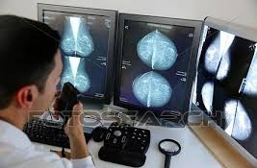
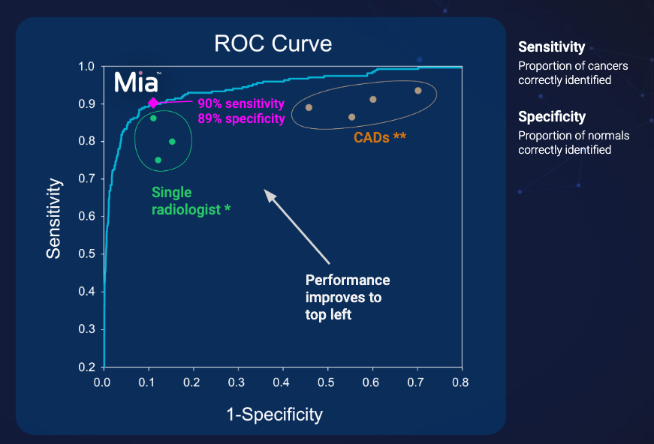
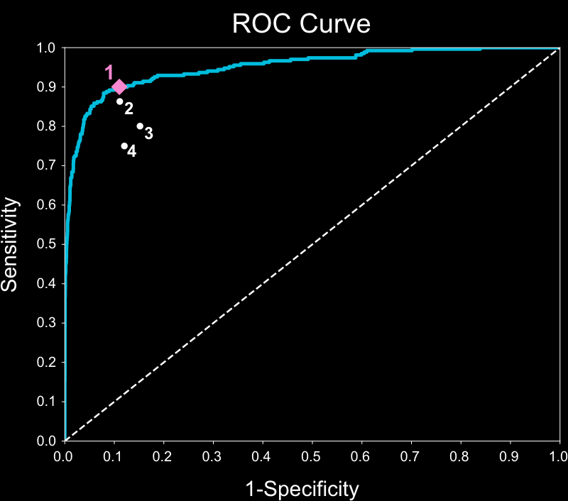
Scottish Breast Screening Programme
+
European CE marked
FDA filings underway
Type to enter a caption.
* jamainternmed.2015.5231 ** Hologic (2014) Imagechecker CAD
Notes:
Kheiron’s MIA or mammography intelligent assessment uses deep learning - a particular version known as convolutional neural networks – which are beginning to bridge the gap between human thinking and AI. Their algorithm already has European CE (conformite European) marking and is going through the process for US food and drug administration approval.

Slide 27
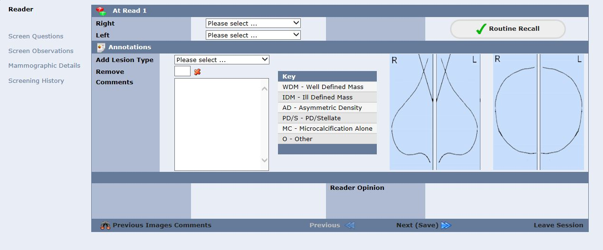
Scottish Breast Screening System
Breast screening in Scotland is 100% digital with all results captured when image read. A single comprehensive set of data is available for AI development.

Slide 28
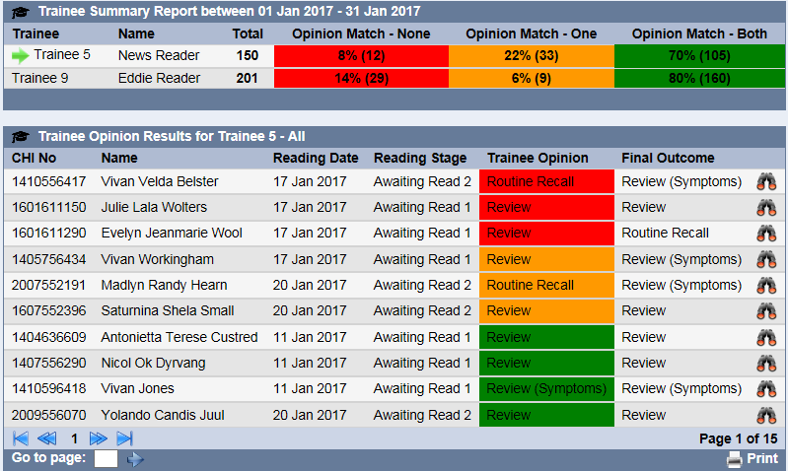
Scottish Breast Screening System
Training module can be used to test AI capability in comparison with current human readers. Data will be used to adjust sensitivity and specificity thresholds

Slide 29
BENEFITS
Real world, nearly real time data collection about performance, decision support impact and usability will be generated.
Reduction in recall rates with increase in cancer detection and reduction in over-diagnosis
World leading integration to support and enhance clinicians.

Slide 30
SUMMARY
The Scottish Breast Screening Programme is ideally placed to evaluate and consider implementation within national guidance
Trust and Governance remains a priority in handling of Scottish clients data.
Body of evidence for AI is promising but further research is ongoing in Scotland with iCaird and other centres worldwide

Slide 31
Thank You for having me
geraldlip@nhs.net

