Slide 1
Optimisation of paediatric x-ray examinations
Mark Worrall
Radiation Physics, Ninewells Hospital
Scottish Medical Physics Network (MPNET)
Chair of the IPEM paediatric optimisation working party

Slide 2
Overview
Assumed knowledge:
Who are MPNET?
What is optimisation?
Where is optimisation undertaken?
Who undertakes optimisation?
How do we gauge optimisation?
Existing sources of comparative data
What is the current status of paediatric DRLs in the UK?
The UK national paediatric dose audits
What other work could the Scottish paediatric SIG look at?
How can we work together moving forward?

Slide 3
Where is optimisation undertaken?
Pre-patient
Patient attends
Protocol set-up
What is the level of image quality required?
Examination kV
AEC choice; AEC receptor dose
CT mA modulation quality indicator
PPS and dose mode
Image processing
Reconstruction, for-display processing
Selection of equipment
Departments have a mix of equipment; where possible send higher risk cohorts to lower dose equipment
DDR vs. CR
Iterative reconstruction CT vs. filtered back projection
Flat panel detector vs. image intensifier

Slide 4
Where is optimisation undertaken?
Examination set-up
Post-processing
Are adjustments to the standard protocol required?
Patient size
Contrast considerations
Grid?
Patient positioning
CT couch height
Position relative to detector / AECs
Collimation
Equipment angulation
Patient compliance
Is the patient comfortable and happy?
Is the patient calm?
Carer or comforter?
Markers
Comments
Additional processing for duplicate images
Additional views; repeat views
Equipment testing
Ensures consistency of performance
Ensures optimised remains optimised
Patient protection
Gonad shields
Other PPE as appropriate

Slide 5
Who undertakes optimisation?
Medical Physics Expert
Reporting clinician (radiologist)
The operator (radiographer)
A local group
The multi-disciplinary team
The specialist
e.g. Play specialist
Paediatrician
Surgeon
The manufacturer

Slide 6
How do we gauge optimisation?
We need to know where to concentrate our efforts
Clinical audit
Image quality scoring?
Positioning?
Consistency?
Reject statistics? – comparison with others
Repeat rates? – comparison with others
Patient dose audit
Average dose for an examination for a representative population
Comparison with local DRLs, national DRLs, other sources of data
Is your site or unit high or low compared with others?

Slide 7
Medical Physics Expert
Reporting clinician (radiologist)
The operator (radiographer)
A local group
The multi-disciplinary team
The specialist
e.g. Play specialist
Paediatrician
Surgeon
The manufacturer

Slide 8
Existing sources of comparative data
National dose audits
Run by the NRPB / HPA / PHE
Intended to be repeated every 5 years
Contingent upon data being voluntarily submitted (though PHE can demand via secretary of state for health)
Contingent upon good quality data
PHE resource issues mean these are less frequent
Other bodies are running their own
IPEM / Breast Screening Physics QA coordinating group / British Society of Cardiovascular Imaging
These are adopted as NDRLs where they meet PHE’s criteria

Slide 9
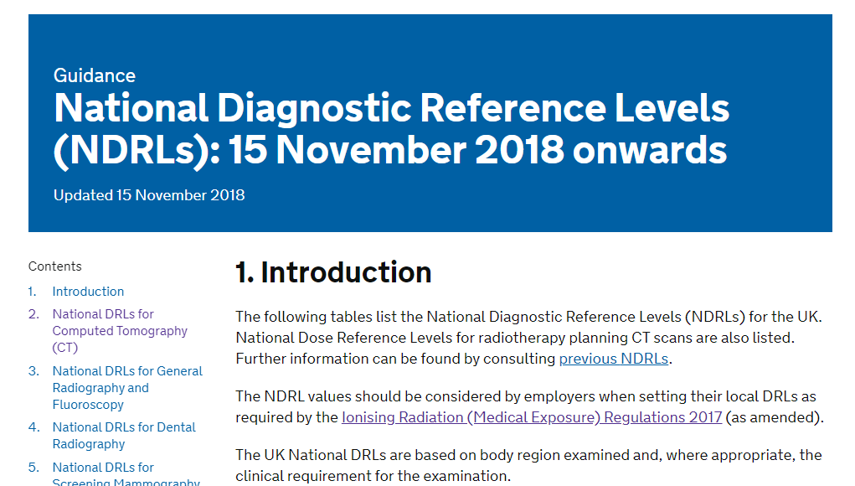
What is the current status of paediatric DRLs in the UK?
https://www.gov.uk/government/publications/diagnostic-radiology-national-diagnostic-reference-levels-ndrls/ndrl

Slide 10
Computed Tomography
Examination | Clinical indication | Scan region / technique | CTD_{vol} per sequence (mGy) | DLP per complete examination (mGy cm)
Paediatric head: 0–1 y | Trauma | All sequences | 25 | 350
Paediatric head: >1–5 y | Trauma | All sequences | 40 | 650
Paediatric head: >5 y | Trauma | All sequences | 60 | 860
Taken from
PHE-CRCE-013: Doses from computed tomography (CT) examinations in the UK (2011 Review).

Slide 11
Fluoroscopy
Examination | Std. Age (yrs) | DAP per exam (Gy cm^2)
Micturating cystourethrography | 0 | 0.1
 | 1 | 0.3
 | 5 | 0.3
 | 10 | 0.4
 | 15 | 0.9
Barium meal | 0 | 0.1
 | 1 | 0.2
 | 5 | 0.2
 | 10 | 0.7
 | 15 | 2.0
Barium swallow | 0 | 0.2
 | 1 | 0.4
 | 5 | 0.5
 | 10 | 1.8
 | 15 | 3.0
Taken from
HPA-CRCE-034: Doses to patients from radiographic and fluoroscopic X-ray imaging procedures in the UK (2010 review)

Slide 12
Radiography
None!
Paediatric data requested in 2010 national radiographic dose audit
Paediatric hospitals directly targeted
Not enough data submitted with patient weight information for national DRL to be proposed

Slide 13
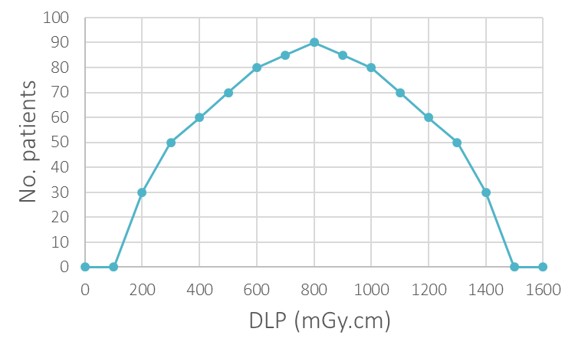
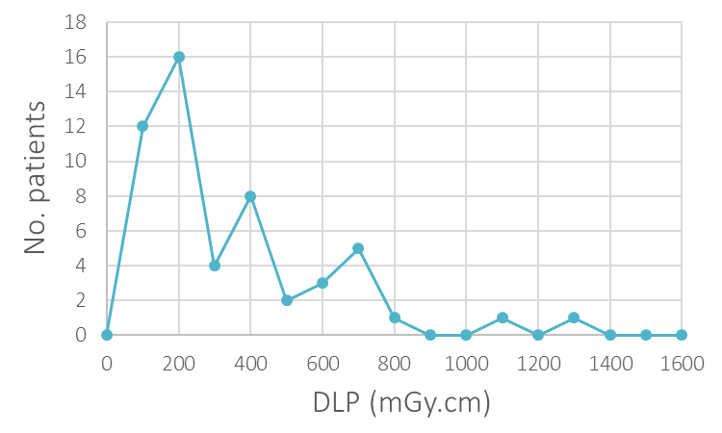
Why do we need weight information?
For paediatric examinations, the spread of data is too wide for the meaningful selection of a single national DRL for all patients
Categorisation by age does not work (except for CT exams of the head)
Examinations of the body must be categorised by weight (or measured patient size)

Slide 14
UK national paediatric dose audits are on the way…
Run by the Institute of Physics and Engineering in Medicine (IPEM)
In collaboration with Public Health England (PHE)
CT dose audit launching soon (May probably)
To run alongside PHE led adult national patient dose audit
To be followed by fluoroscopy / interventional patient dose audit
To be followed by radiographic patient dose audit
The paediatric national dose audits will require weight information for each patient
The dose audit uses an Excel pro-forma and will be circulated via a well used Medical Physics mailbase
The dose audits have been approved for CPD accreditation by the SCoR
We suggest they be completed by radiographers and medical physics colleagues
The paediatric national dose audits will lead to updated national DRLs!
The biggest barrier to successful dose audits is the provision of weight information
Are you in a position to weigh patients, or obtain weight from another clinical system?

Slide 15
What can the paediatric SIG do to help with optimisation?
Facilitating the collection of useful comparative data…
There is little point in undertaking competing Scottish national dose audits
Let’s all participate in the UK wide one launching soon
Happy to consider this in the future…
Facilitate collection and dissemination of useful comparative data
Reject statistics, repeat rates?
Average doses for other regularly undertaken examinations that are not included in the UK national dose audits?
Protocol selections?
MPNET can help design the studies and analyse the data
Then local multi-disciplinary teams can use this data to evaluate and improve their own practice

Slide 16
How can we work together?
Educational events or materials?
Technology is advancing all the time – is there a role for MPNET in delivering training on how certain components work?
e.g. I have recently delivered local training on how iterative reconstruction works to NHS Tayside CT radiographers
What about flat panel detectors in fluoroscopy?
What about how fluoroscopy equipment selects kV, mA during an examination?
What about DR vs. CR technology in radiography? Why is DR lower dose?

Slide 17
How can we work together?
Short projects – What would happen if? Does it matter if?
Have you ever wondered what the effect of changing something on your equipment would be?
e.g. are you curious to know what would happen to the AEC functionality on a CT scanner if the patient wasn’t centred?
Are you curious to know whether it matters which mattress you use during a fluoroscopy procedure?
Are you curious to know whether the anode-heel effect in general radiography is better than a gonad shield?
Do you have time to investigate? Do you only get to do research as part of an MSc or other qualification?
Medical physics have a steady stream of trainees who are all required to undertake a research project as part of their training
Let’s use our resources wisely
Any other ideas?

Slide 18
Questions and discussion

