Slide 1
Scottish Clinical Imaging Network 30/4/15
Direct Access to Cross Sectional Imaging for General Practitioners

Slide 2
WHY?

Slide 3
GPs have, by default, taken on the role of the General Physician
They have not been given the same level of diagnostic access
Good evidence that GP direct access speeds and smoothes the patient journey
SG, RCR and RCGP want it to happen

Slide 4
Why has it not happened?
Radiologists fear becoming more overwhelmed than they already are
GPs fear being lumped with even more un-resourced work from secondary care
Lack of GP experience and expertise with this type of imaging

Slide 5
What has our group being looking at?
Initially everything! Quickly realised we had to focus on one key area that might show the way to develop other areas in the future
The Primary Care Cancer Group focussed the Discussion
Focussed on very ill patients who may have an underlying malignancy but whose symptoms do not fit into any existing referral streams.

Slide 6
What Did We Manage to Agree On?
All agree there is still work to be done but this particular area merits GP direct access
Other forms of direct access are best done via protocols supported by the relevant specialty. Examples of this already exist e.g. Knee MR
There needs to be uniform access and an equitable approach across Scotland
If SG want this, they need to resource it

Slide 7
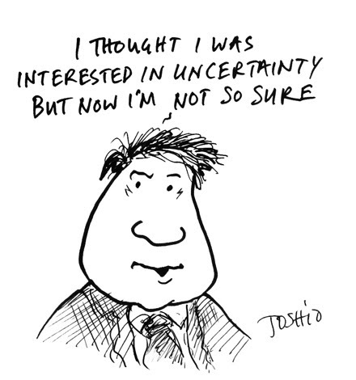
What do you mean you don’t know what’s wrong with them?

Slide 8
Uncertainty
Managing uncertainty is a key skill for GPs
GPs are presented with increasingly complex problems, often seeing many in the same day
It can be difficult to tease out the underlying problem. Is it poverty, drugs, alcohol, stress, depression, anxiety, malignancy or something else?

Slide 9
Undifferentiated Presentations
Some cancers present in a way that does not allow the GP to narrow in on the likely primary.
The presentations often involve significant weight loss, but not always.
Vague “soft” symptomatology including fatigue, loss of appetite and malaise are often presented.

Slide 10
This is NOT to Replace What We Already Have in Place
Not to replace the current “Urgent – Suspicion of Cancer” referrals to the appropriate specialty.
There should be no localising symptoms
Direct access to CT would only be after a thorough work up by GP
History, examination (including screen for depression), defined blood panel and CXR

Slide 11
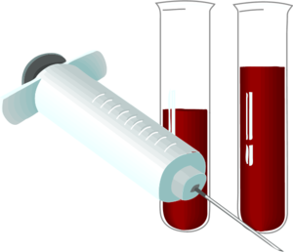
Defined Blood Panel
U&E, LFTS, GLUC, TSH, BONE PROFILE,CRP, LDH, FBC, ESR, Ca125 (F), PSA (M). Myeloma Screen if ESR significantly raised.

Slide 12
What Next Once Work Up is Complete?
Copies of "Suggested Pathway for Primary Care Direct Access to CT Chest/Abdomen/Pelvis for Patients with Unidentified Suspected Malignancy” are on your tables
This is what GPs will use for guidance when looking to refer for CT scanning
We would like your feedback on this today. Feedback forms are on your tables

Slide 13
What Will GPs Need From Radiology

Slide 14
An accessible colleague with expert knowledge
Quick, understandable reports that highlight important findings
Possibly shared educational events. GPs have no ongoing radiology training and Radiologists would gain from spending time in General Practice. Yes you would!

